Slide 1
Lab #7
Attitude Control

Slide 2
Intro
In this lab you will integrate and test KestrelSAT’s attitude control system.
You will connect the reaction wheel to a motor controller, and the motor controller to KestrelSAT’s MCU. Additionally, you’ll connect an encoder on the motor to the MCU, which will allow KestrelSAT to measure wheel speed.
You will suspend KestrelSAT from a string and change its orientation about it’s Z axis by varying the speed of the reaction wheel.
You will measure system performance to ensure that KestrelSAT can meet orbital torque and momentum requirements.
Authorized Resources - PRELAB
Prelab turn-in is individual effort
Generative AI Level 0 Allowed (GenAI not allowed)
Astro 331 course notes/ instructor
Intro
KestrelSAT
Reference
Prelab
Task 1
Task 2
Task 3
Task 4
Turn-in Reqt’s
Authorized Resources – LAB & LAB REPORT
Lab activities & lab report are team effort
Any non-human resource
Generative AI Level 3 Allowed
Astro 331 course notes/instructor
Objectives:
Understand fundamentals of attitude control via practical experimentation.
Interpret wheel command and speed measurements.
Observe a functional test demonstrating a basic slew maneuver using a reaction wheel.
Estimate reaction wheel torque and momentum based on test data.
Estimate spacecraft MOI based on test data.

Slide 3
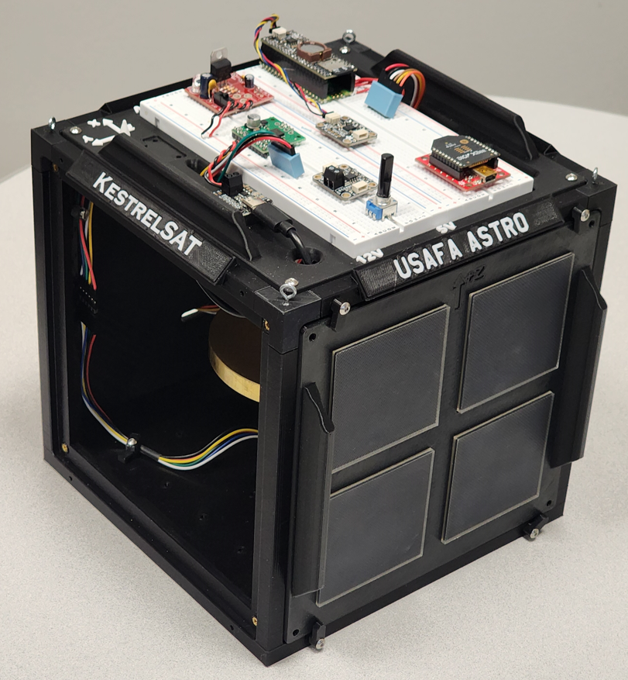
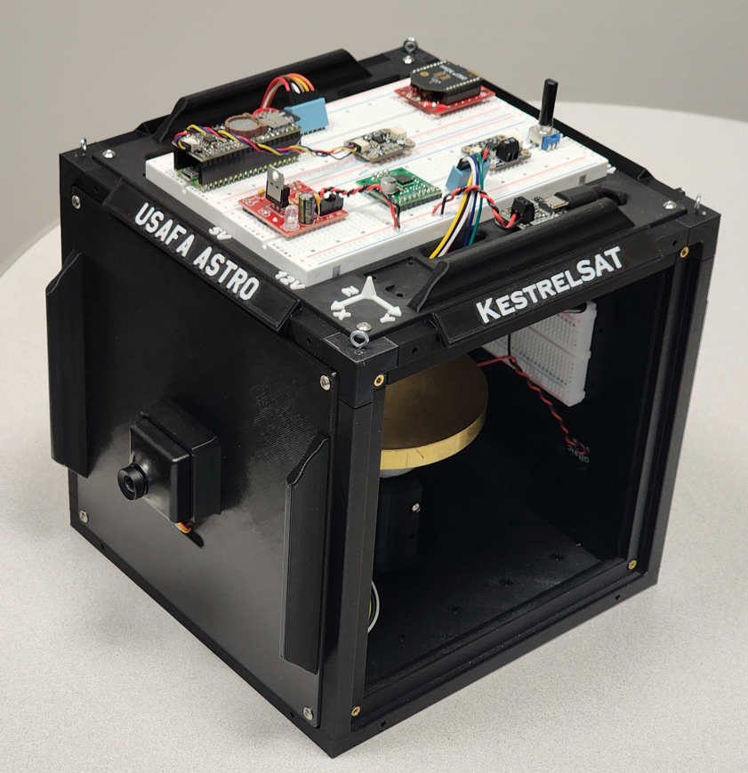
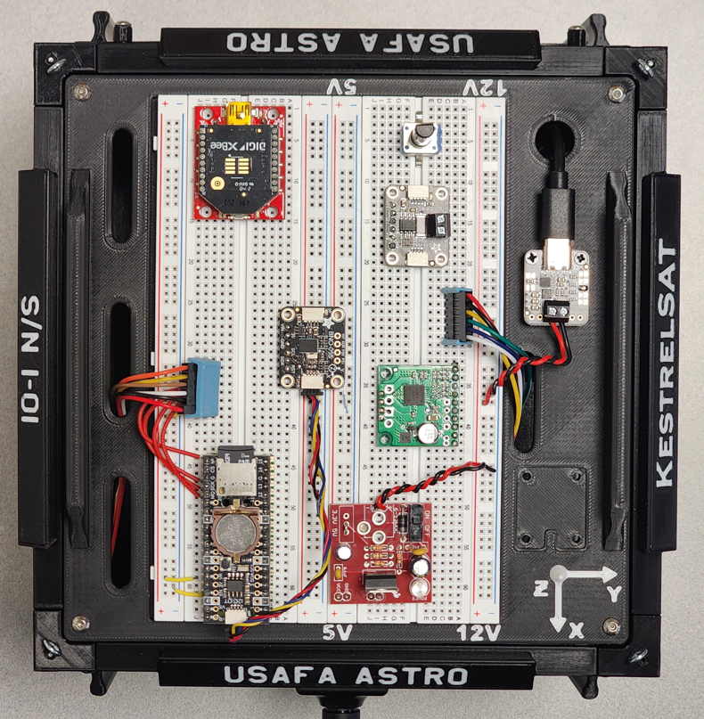
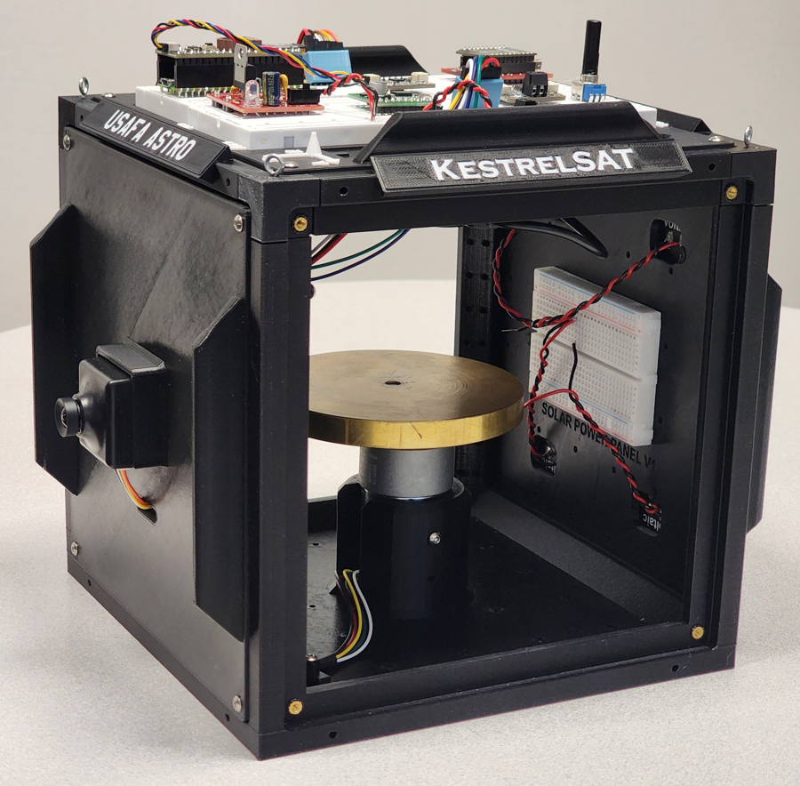
KestrelSAT Overview
Intro
KestrelSAT
Reference
Prelab
Task 1
Task 2
Task 3
Task 4
Turn-in Reqt’s
Solar Power Side
Reaction Wheel
Camera Side
Solar Power
V & I Sensor
Comm (Xbee transceiver)
Battery Controller
IMU (BNO055)
Motor Driver
MCU (Rpi Pico)
Memory (SD)
Real-Time Clock
12V DC to 5V DC Regulator

Slide 4
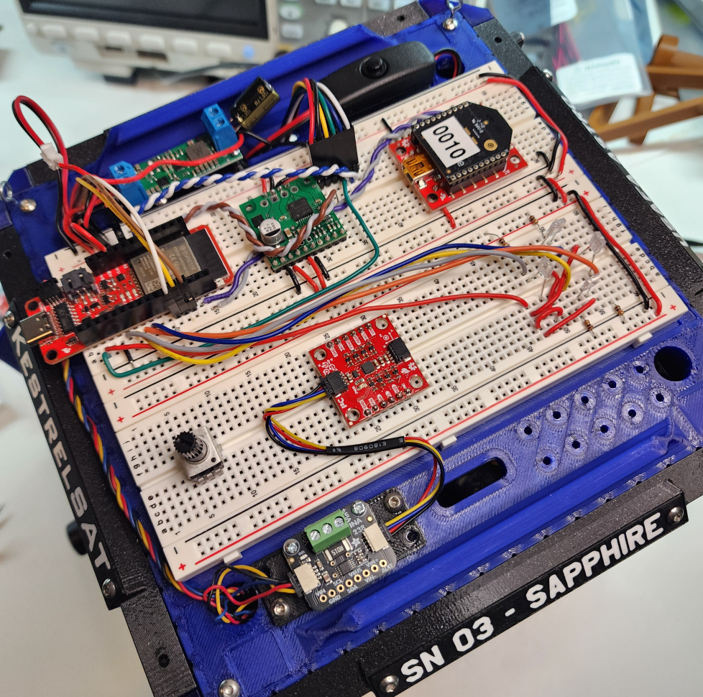
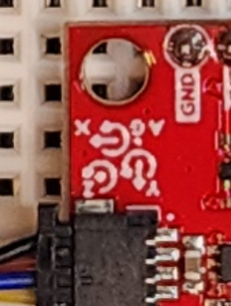
Reference – KestrelSAT Body Frame Coordinate System
Intro
KestrelSAT
Reference
Prelab
Task 1
Task 2
Task 3
Task 4
Turn-in Reqt’s
+Z points vertically up out of top of KestrelSAT
+Z
+
+
+X
+
+Y
Astro 331 Lab #6
4

Slide 5
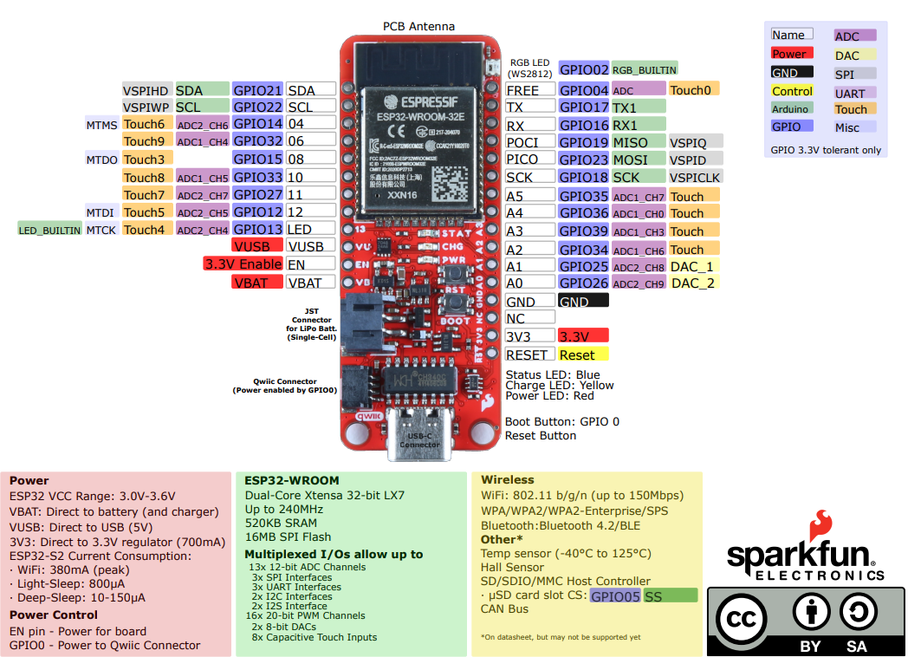
ESP32 Thing Plus Pinout Diagram
Intro
KestrelSAT
Reference
Task 1
Task 2
Task 3
Task 4
Turn-in Reqt’s

Slide 6
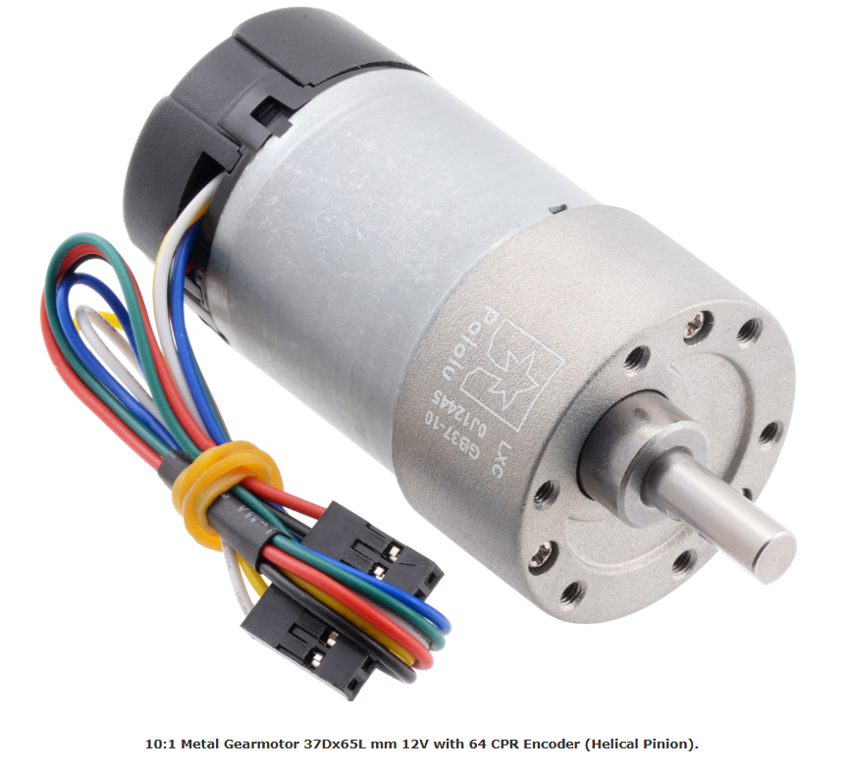

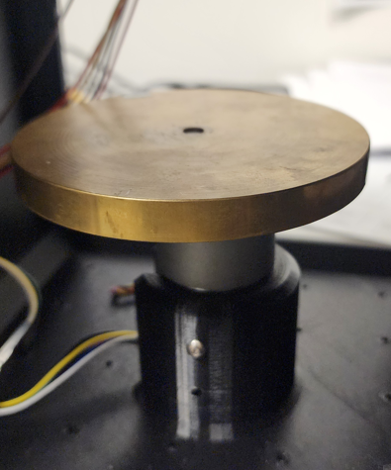
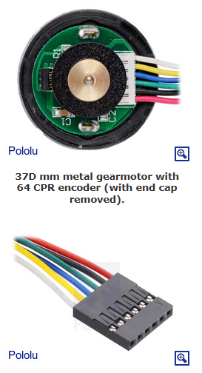
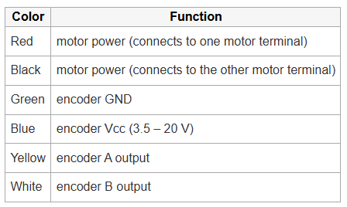
Reference – KestrelSAT Reaction Wheel
Intro
KestrelSAT
Reference
Prelab
Task 1
Task 2
Task 3
Task 4
Turn-in Reqt’s
KestrelSAT’s reaction wheel uses a 12V brushed DC motor with a 10:1 metal gearbox and an integrated quadrature encoder.
To measure wheel speed, a two-channel Hall effect encoder is used to sense the rotation of a magnetic disk on a rear protrusion of the motor shaft.
The quadrature encoder provides a resolution of 64 counts per revolution (CPR) of the motor shaft and 640 CPR of the gearbox’s output shaft.
More Information:
Pololu item 4758
Note: KestrelSAT uses an extension cable whose colors do not exactly match those listed above. See Task 2 for correct setup.

Slide 7
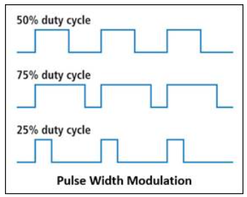
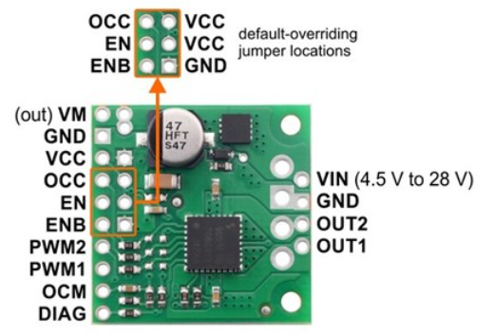
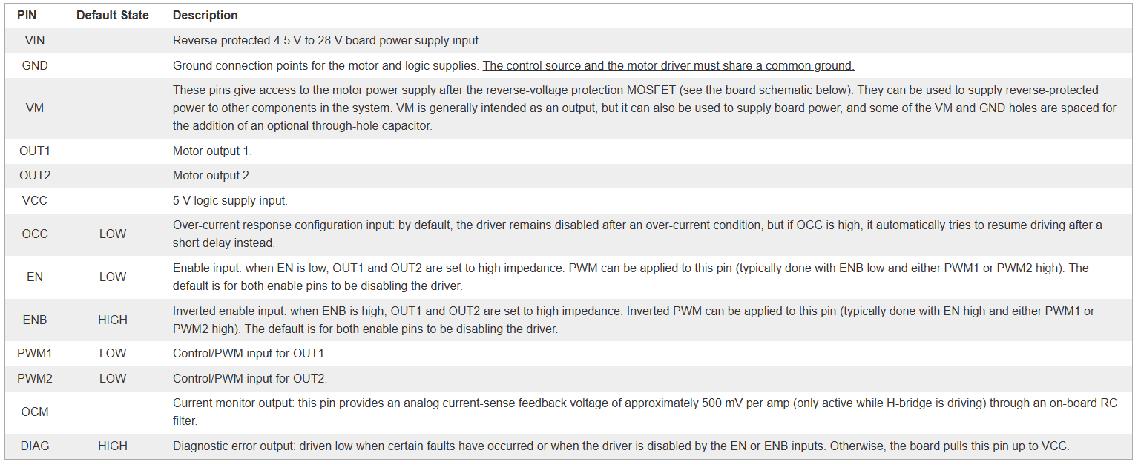
Reference – Motor Controller
KestrelSAT uses a TB9051FTG Single Brushed DC Motor Driver to control the reaciton wheel.
The motor driver provides 0–12* V to the motor, modulated to control motor speed.
The modulation is controlled by a 3V pulse PWM (pulse width modulation) signal from the MCU.
The higher the PWM command, the faster the motor will spin.
* - In this lab we’ll use 5V to power the motor
More information: https://www.pololu.com/product/2997
Intro
KestrelSAT
Reference
Prelab
Task 1
Task 2
Task 3
Task 4
Turn-in Reqt’s

Slide 8
Prelab Tasks
Authorized Resources
Prelab turn-in is individual effort
Generative AI Level 0 Allowed (GenAI not allowed)
Astro 331 course notes/instructor
Turn-In Format
Provide answers digitally using Word, PowerPoint, or LaTeX.
Math work may be handwritten. If it is, make sure it is legible/organized and include a high-quality scan of it in your turn-in file.
Include a documentation statement.
Intro
Reference
Prelab
Task 1
Task 2
Task 3
Turn-in Reqt’s
For the Prelab, your task is to determine if KestrelSAT’s reaction wheel can provide sufficient torque and angular momentum storage for its mission.
Refer to next slide for relevant KestrelSAT and reaction wheel parameters.
Determine Reaction Wheel Requirements:
(P1) Calculate the total torque required to counter disturbances that we discussed in class (gravity gradient, magnetic, SRP, drag). Assume a margin factor of 1 (margin is considered in P6).
[Refer to page 194 of Dahlke text to calculate atmospheric density]
(P2) Calculate the angular momentum storage requirement of the reaction wheel to counter these disturbances (assume momentum is stored for one orbit).
(P3) Calculate the torque required to complete a 180 degree slew maneuver in 3 seconds.
Determine Reaction Wheel Capability:
(P4) Calculate the torque that KestrelSAT’s reaction wheel can produce.
(P5) Calculate how much angular momentum KestrelSAT’s reaction wheel can store.
Determine Design Margin:
(P6) Calculate design margin for each reaction wheel requirement (disturbance torque, angular momentum storage, slew torque).
(P7) If any of the three design margins are negative, propose a specific parameter change(s) and recalculate margins to show they are positive.

Slide 9
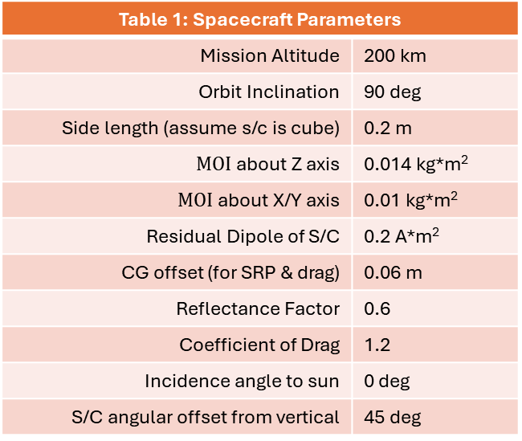
Prelab Tasks
Intro
Reference
Prelab
Task 1
Task 2
Task 3
Turn-in Reqt’s
Table 1: Spacecraft Parameters
Mission Altitude | 200 km
Orbit Inclination | 90 deg
Side length (assume s/c is cube) | 0.2 m
$MOI$ about Z axis | 0.014 kg*m²
$MOI$ about X/Y axis | 0.01 kg*m²
Residual Dipole of S/C | 0.2 A*m²
CG offset (for SRP & drag) | 0.06 m
Reflectance Factor | 0.6
Coefficient of Drag | 1.2
Incidence angle to sun | 0 deg
S/C angular offset from vertical | 45 deg
Table 2: Reaction Wheel Parameters
MOI of Reaction Wheel | 0.0035 kg*m²
Max Wheel Speed | 410 RPM
Wheel Angular Acceleration | 50 RPM/sec

Slide 10
Prelab 7 Notes for Next Semester
Make cadets use MLX?
Give margin equaition
Use SRP eqn from eqn sheet (not Dahlke)

Slide 11
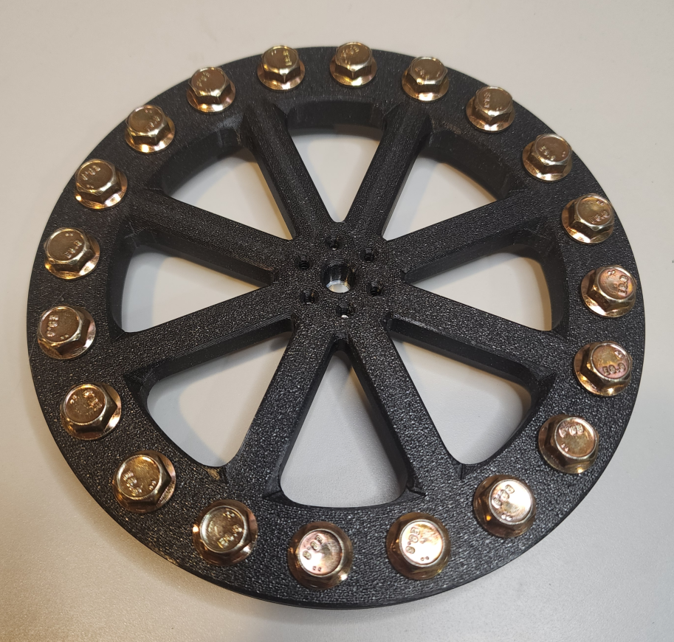
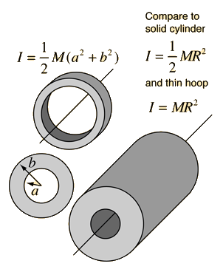
Task 1 – Measure Reaction Wheel Properties
Intro
KestrelSAT
Reference
Prelab
Task 1
Task 2
Task 3
Task 4
Turn-in Reqt’s
KestrelSAT’s uses a 3D printed reaction wheel with M6 bolts placed around the perimeter to increase its Moment of Inertia (MOI).
Using the spare reaction wheel rotor available in the lab:
Measure the outer and inner diameter (i.e. inside diameter of ring with bolts) of the wheel.
Measure the mass of the wheel.
In your lab report, use these values to calculate moment of inertia of the wheel. Assume the mass is entirely distributed about the perimeter so that you can model the wheel as a hollow cylinder.

Slide 12
Task 2 – Connect Reaction Wheel & Motor Controller
Intro
KestrelSAT
Reference
Prelab
Task 1
Task 2
Task 3
Task 4
Turn-in Reqt’s
Make the following connections with the motor controller, reaction wheel and MCU:
Motor Controller
High voltage side (4 pins)
Vin = 5V supply (direct from battery)
Gnd = ground
Out2 = to motor black
Out1 = to motor red
Low voltage side (10 pins)
VM = NC (NC means not connected)
Gnd = ground (make sure there is a common ground w/ MCU)
Vcc = 5V
OCC = NC
EN = 5V
ENB = ground
PWM1 = MCU GPIO 33 (PWM Control Pin)
PWM2 = MCU 15 (PWM Control Pin)
OCM = NC
DIAG = NC
Motor connections*
Black = as described previously (motor controller)
Red = as described previously (motor controller)
Yellow = ground (ground for quadrature encoder--wheel speed sensor)
Green = 3.3V (power for quadrature encoder--wheel speed sensor)
Blue = MCU GPIO 14 (signal from quadrature encoder)
White = MCU GPIO 32 (signal from quadrature encoder)
WARNING
Ensure you connect green wire from motor to 3.3V pin on the MCU, not 5V
* - Note the color connections on this slide correlate to the motor extension cable, not the cable directly connected to the motor.

Slide 13
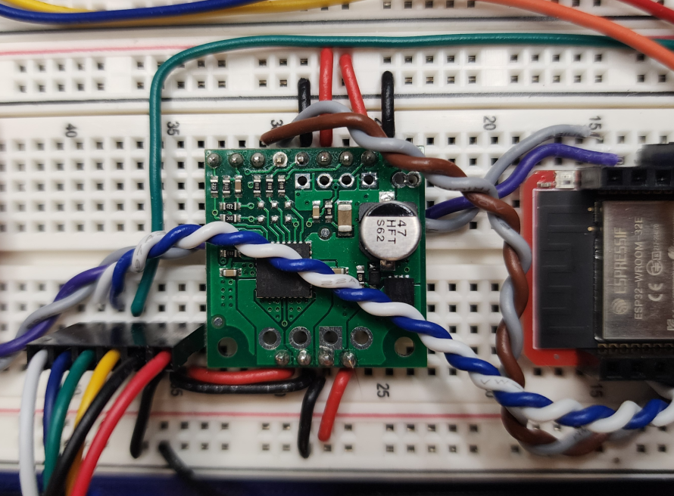
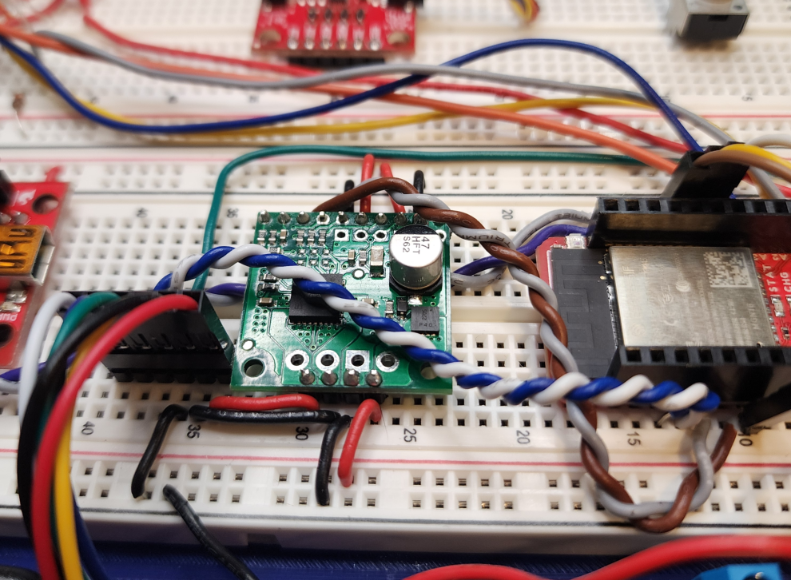
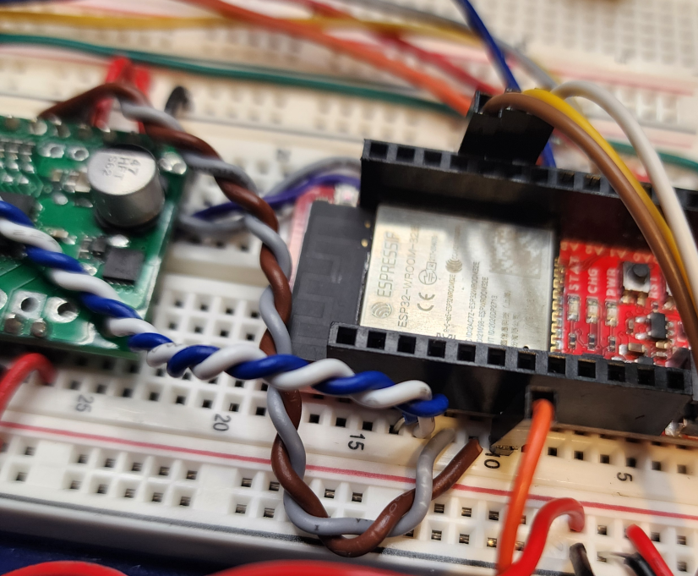
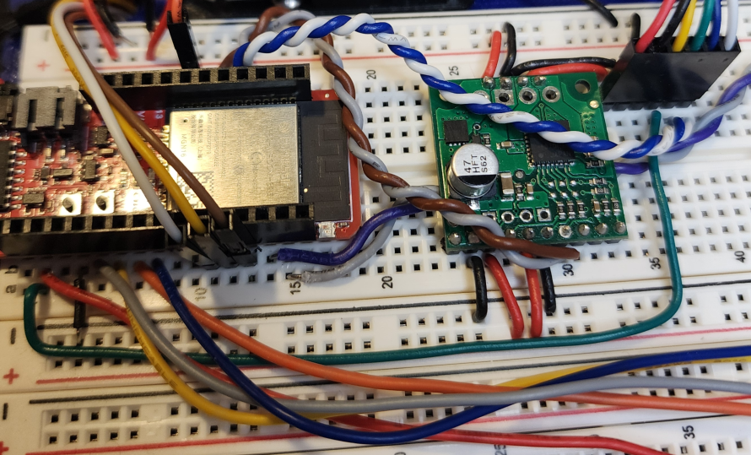
Task 2 – Reference Photos
Intro
KestrelSAT
Reference
Prelab
Task 1
Task 2
Task 3
Task 4
Turn-in Reqt’s

Slide 14
Task 3 – Upload Code to KestrelSAT
Intro
KestrelSAT
Reference
Prelab
Task 1
Task 2
Task 3
Task 4
Turn-in Reqt’s
Download Astro331_Lab7_Code folder from Teams or your instructor’s USB drive.
Upload the code using PlatformIO. The RGB LED on the MCU should shine green if the IMU and SD card initialize correctly.
For this lab you can connect to KestrelSAT either over USB or using Xbee wireless connection. For either method, there are several available options:
* | Cmd | Function |
* |-----|----------|
* | 0 | Stop reaction wheel |
* | 1 | Display options menu |
* | 2 | Query XBee RSSI |
* | 3 | Toggle status LED |
* | 4 | Get battery telemetry (V, SOC, charge rate) |
* | 5 | Manually set reaction wheel throttle (-100 to 100%) |
* | 6 | Run Lab 6 test (Attitude Determination) |
* | 7 | Run Lab 7 Test A (tabletop static, RW torque measurement) |
* | 8 | Run Lab 7 Test B (dynamic test with prescribed wheel speed) |
* | 98 | SD Card: List files (USB Serial only) |
* | 99 | SD Card: Print file (USB Serial only) |
Note: when a Lab 6 or 7 Test Run is executed, sensor data is only streamed over USB (not XBee). Each time a test run is executed, a new .csv file containing the test data is saved to the SD card connected to the MCU.

Slide 15
Task 3A – Reaction Wheel Checkout
Intro
KestrelSAT
Reference
Prelab
Task 1
Task 2
Task 3
Task 4
Turn-in Reqt’s
With the KestrelSAT connected via USB send a ‘5’ command to KestrelSAT to manually set the speed of the reaction wheel. Set the throttle to 100.
Send a ‘9’ command to stream the reaction wheel’s speed. The speed of the wheel at 100% throttle should be about 400 rpm.
Send ‘x’ to cancel the stream, and ‘0’ to stop the reaction wheel.

Slide 16
Task 4A – Run Test A
Intro
KestrelSAT
Reference
Prelab
Task 1
Task 2
Task 3
Task 4
Turn-in Reqt’s
Test A commands a simple step of the motor speed from 0 RPM to maximum speed:
The wheel is stationary for 3 seconds, accelerates to full speed for 7 seconds, then returns to stationary.
During this time, commanded and measured wheel speed is recorded to a .csv file on the SD card.
Run Test A with KestrelSAT stationary on your workbench.
Collect test data from the SD card for postlab analysis.
After the lab, calculate the wheel’s angular acceleration as it ramps up to full speed, and use this to estimate wheel torque and momentum.

Slide 17
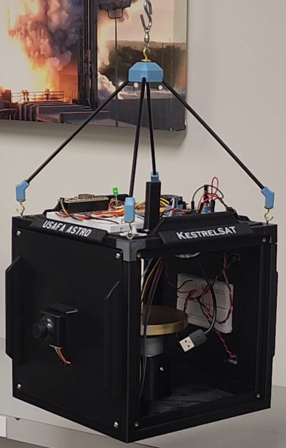
Task 4B – Run Test B
Intro
KestrelSAT
Reference
Prelab
Task 1
Task 2
Task 3
Task 4
Turn-in Reqt’s
Test B demonstrates a basic slew maneuver using the reaction wheel.
The maneuver is open-loop: the wheel runs at a prescribed set of speeds over the 40 second test. No sensor data is used to adjust motor speed commands or S/C angular position.
Hang KestrelSAT above your workstation and power it on. Connect to KestrelSAT over XBee.
Have one group member hold KestrelSAT still while another initiates Test B. Continue to hold KestrelSAT still while the wheel accelerates. Smoothly let go of KestrelSAT when then RGB LED turns blue.
After a brief pause, KestrelSAT should slew approximately 180 degrees, pause, then slew 180 degrees back to its original orientation.
After this, the wheel will turn off and KestrelSAT will spin freely. Do not touch KestrelSAT until ‘Test Complete’ is indicated.
Collect the test data .csv file from the SD card for postlab analysis.
Before looking at the test data, use your intuition and knowledge of reaction wheel slew maneuvers to predict the wheel speed profile. Discuss with your instructor.

Slide 18
Lab Report 2 Guidance
***Note your Lab Report 2 will cover Lab #6 and Lab #7***
Intro
KestrelSAT
Reference
Prelab
Task 1
Task 2
Task 3
Task 4
Turn-in Reqt’s
General guidance: Use well formatted plots and tables to convey information. Always comment of potential sources of error and include recommendations for how to fix them.
In addition to the items specified in Lab 6 guidance, include the following in your Lab Report 2.
Using data you recorded about the reaction wheel and from Test A, estimate the reaction wheel’s torque and angular momentum.
Compare to your predictions from the prelab. Comment on whether the reaction wheel meets mission requirements.
Using data from Test B:
Calibrate the magnetometer data. Estimate and plot magnetic heading using both the magnetometer data and gyroscope data (as you did for Lab 6). Analyze and compare these estimates. If the solutions drift apart, discuss possible reasons why.
Estimate the MOI of KestrelSAT. Do this with the wheel speed data and gyroscope data immediately before and after the wheel turned off.
Did your KestrelSAT return perfectly to its original orientation? If not, comment on possible reasons why not.
Thoroughly comment on any other observations made during the lab or analysis.

